Slide 1

Signal Processing III (Discrete Fourier Transform)
Chul Min Yeum
Assistant Professor
Civil and Environmental Engineering
University of Waterloo, Canada
CIVE 497 – CIVE 700: Smart Structure Technology
Last updated: 2021-01-09

Slide 2
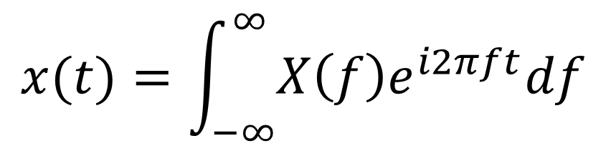
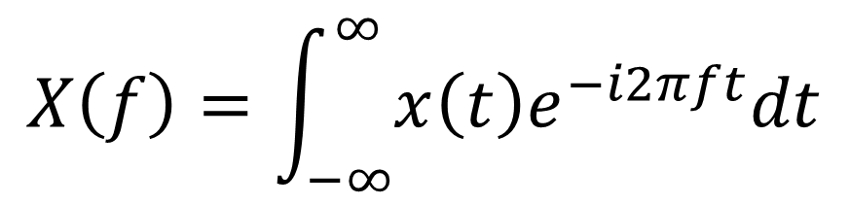
Fourier Integral Pair (Fourier Transform)
$$x(t)=\int_{−∞}^{∞}{X\left(f\right)e^{i2πft}df}$$
$$X\left(f\right)=\int_{−∞}^{∞}{x\left(t\right)e^{−i2πft}dt}$$
The Fourier transform (FT) decomposes a function of continuous time (a signal) into its constituent frequencies. Inverse Fourier transform is to reconstruct the signals using frequencies and its amplitude.

Slide 3
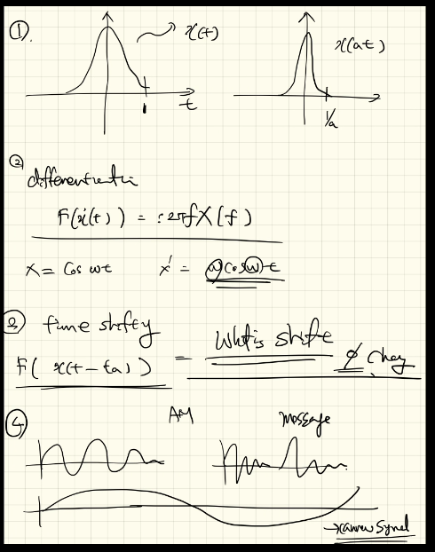


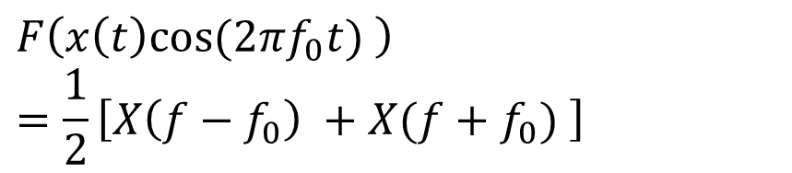

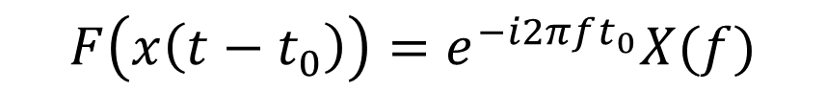

Properties of Fourier Transforms
1. Time scaling
2. Time reversal
$$F\left(x\left(at\right)\right)=\frac{1}{\left|a\right|}X(\frac{f}{a})$$
$$F\left(x\left(−t\right)\right)=X(−f)$$
3. Differentiation
Q: What does this mean by?
5. Modulation
$$F\left(\dot{x}\left(t\right)\right)=i2πfX(f)$$
$$F\left(x\left(t\right)e^{i2πf_{0}t}\right)=X(f−f_{0})$$
4. Time shifting
$$F\left(x\left(t\right)cos⁡(2πf_{0}t) \right)=\frac{1}{2}\left[X\left(f−f_{0}\right) +X(f+f_{0}) \right]$$
$$F\left(x\left(t−t_{0}\right)\right)=e^{−i2πft_{0}}X(f)$$
Only phase shift !
Sine wave

Slide 4
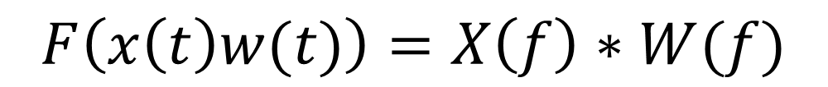
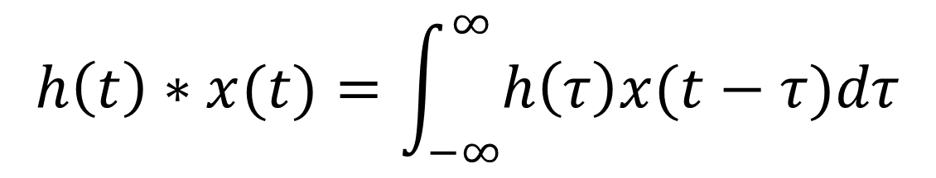

Properties of Fourier Transforms (Convolution)
$$F\left(h\left(t\right)∗x(t)\right)=H\left(f\right)X(f)$$
$$F\left(x\left(t\right)w(t)\right)=X\left(f\right)∗W(f)$$
Where the convolution of the two functions $h\left(t\right)$ and $x(t)$ is defined as
$$h\left(t\right)∗x(t)=\int_{−∞}^{∞}{h\left(τ\right)x(t−τ)dτ}$$
It is a function of time !

Slide 5
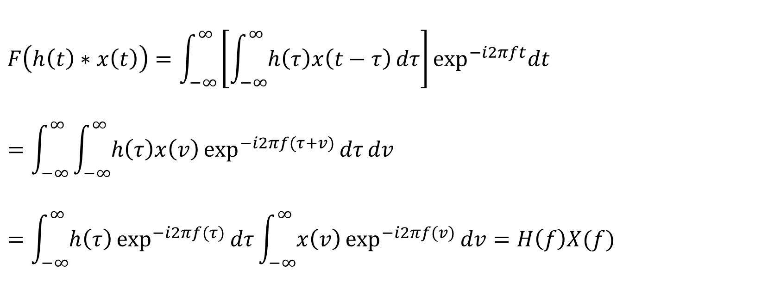
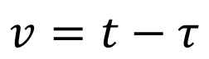
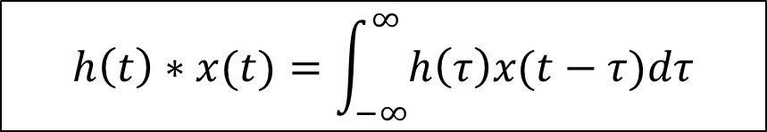
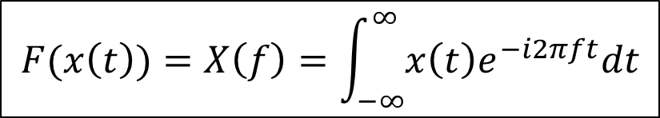
Proof of Convolution Relationship
Supplement
$$F\left(h\left(t\right)∗x(t)\right)=H\left(f\right)X(f)$$
$$F\left(h\left(t\right)∗x\left(t\right)\right)=\int_{−∞}^{∞}{\left[\int_{−∞}^{∞}{h\left(τ\right)x\left(t−τ\right){dτ}}\right]\exp^{−i2πft}dt}=\int_{−∞}^{∞}{\int_{−∞}^{∞}{h\left(τ\right)x\left(v\right)\exp^{−i2πf(τ+v)}{dτ}}dv}=\int_{−∞}^{∞}{h\left(τ\right)\exp^{−i2πf(τ)}{dτ}}\int_{−∞}^{∞}{x\left(v\right)\exp^{−i2πf(v)}{dv}}=H\left(f\right)X(f)$$
Proof:
Fubini’s Theorem
$$v=t−τ$$
$$F(x\left(t\right))=X\left(f\right)=\int_{−∞}^{∞}{x\left(t\right)e^{−i2πft}dt}$$
$$h\left(t\right)∗x(t)=\int_{−∞}^{∞}{h\left(τ\right)x(t−τ)dτ}$$
Fourier integral
Conovlution

Slide 6
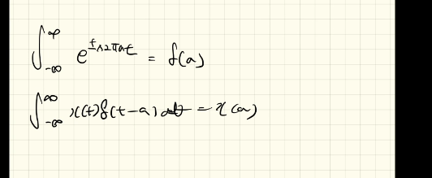
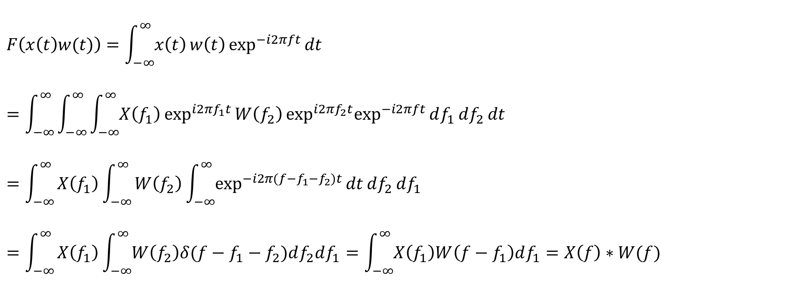
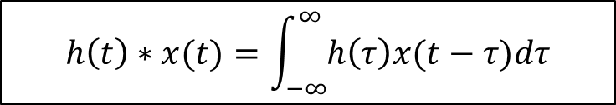

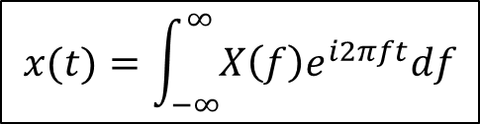
Proof of Convolution Relationship (Continue)
Supplement
$$F\left(x\left(t\right)w(t)\right)=X\left(f\right)∗W(f)$$
$$F\left(x\left(t\right)w(t)\right)=\int_{−∞}^{∞}{x\left(t\right)w\left(t\right){\exp^{−i2πft}{dt}}}$$
$$=\int_{−∞}^{∞}{\int_{−∞}^{∞}{\int_{−∞}^{∞}{X\left(f_{1}\right)\exp^{i2πf_{1}t}{W\left(f_{2}\right)\exp^{i2πf_{2}t}\exp^{−i2πft}{df_{1}}}}df_{2}}dt}=\int_{−∞}^{∞}{X\left(f_{1}\right)\int_{−∞}^{∞}{W\left(f_{2}\right)\int_{−∞}^{∞}{\exp^{−i2π(f−f_{1}−f_{2})t}{\operatorname{dt}{df_{2}}}}df_{1}}}$$
$$=\int_{−∞}^{∞}{X\left(f_{1}\right)\int_{−∞}^{∞}{W\left(f_{2}\right)δ(f−f_{1}−f_{2})df_{2}df_{1}}=\int_{−∞}^{∞}{X\left(f_{1}\right)W\left(f−f_{1}\right)df_{1}}=X\left(f\right)∗W(f) }$$
Proof:
$$F(x\left(t\right))=X\left(f\right)=\int_{−∞}^{∞}{x\left(t\right)e^{−i2πft}dt}$$
$$h\left(t\right)∗x(t)=\int_{−∞}^{∞}{h\left(τ\right)x(t−τ)dτ}$$
$$x(t)=\int_{−∞}^{∞}{X\left(f\right)e^{i2πft}df}$$

Slide 7
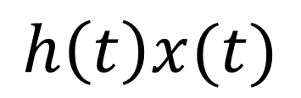
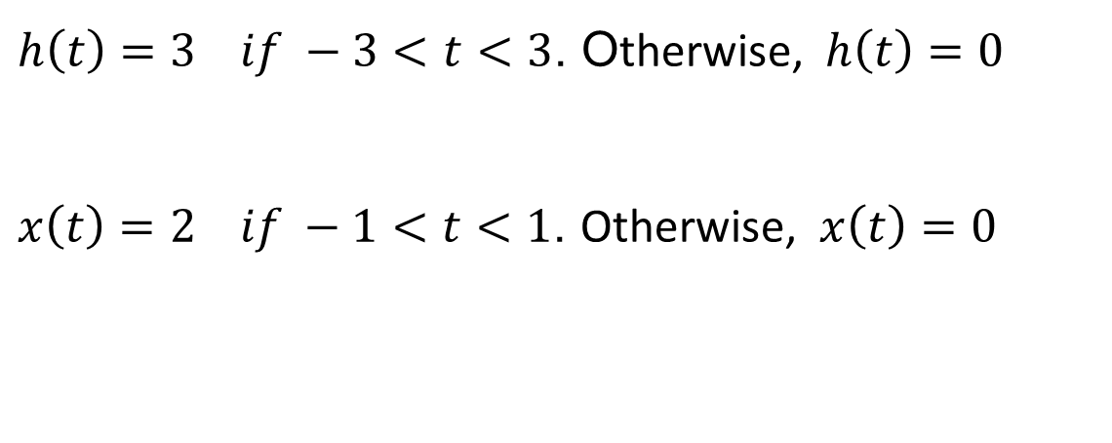
Example: Convolution 1 (Square Wave)
$h\left(t\right)=3 if −3<t<3$. Otherwise, $h\left(t\right)=0$
$x\left(t\right)=2 if −1<t<1$. Otherwise, $x\left(t\right)=0$
$$h\left(t\right)x(t)$$
Multiply values of h and x at each time point
Tutorial

Slide 8
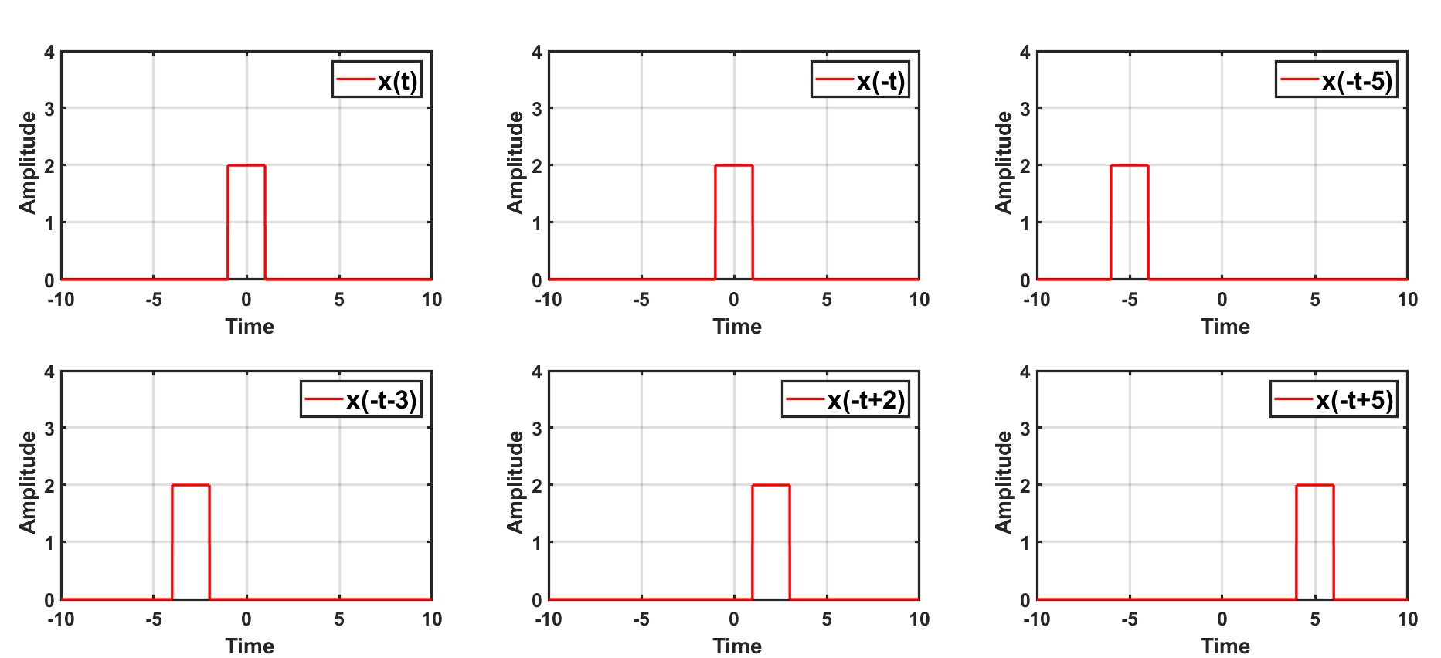
Time Shifting
Supplement
Tutorial

Slide 9
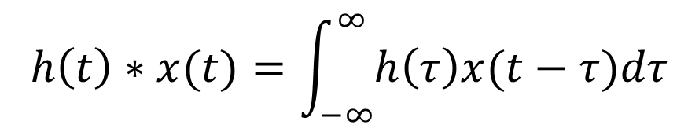
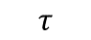
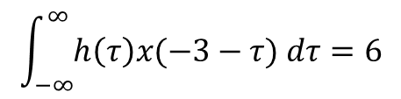
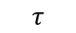
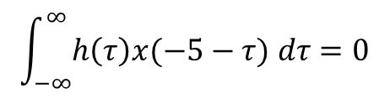
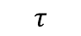

Example: Convolution 1 (Square Wave) (Continue)
Tutorial
Convolution
$$h\left(t\right)∗x(t)=\int_{−∞}^{∞}{h\left(τ\right)x(t−τ)dτ}$$
$$τ$$
$$τ$$
$$τ$$
$$τ$$
$$\int_{−∞}^{∞}{h\left(τ\right)x(−5−τ) dτ}=0$$
It is for finding a value of x(t)*h(t) at t= -5
$$\int_{−∞}^{∞}{h\left(τ\right)x(−3−τ) dτ}=6$$
It is for finding a value of x(t)*h(t) at t= -3

Slide 10
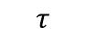
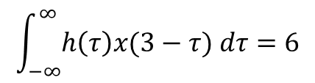

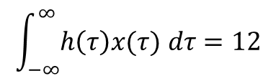


Example: Convolution 1 (Square Wave) (Continue)
Tutorial
Convolution
$$h\left(t\right)∗x(t)=\int_{−∞}^{∞}{h\left(τ\right)x(t−τ)dτ}$$
$$τ$$
$$τ$$
$$τ$$
$$τ$$
$$\int_{−∞}^{∞}{h\left(τ\right)x(τ) dτ}=12$$
It is for finding a value of x(t)*h(t) at t= 0
$$\int_{−∞}^{∞}{h\left(τ\right)x(3−τ) dτ}=6$$
It is for finding a value of x(t)*h(t) at t= 3

Slide 11
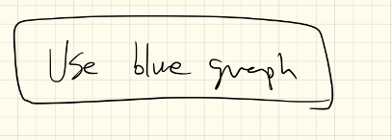
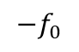
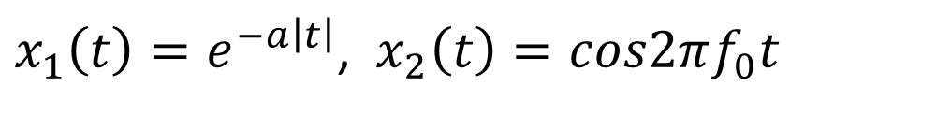
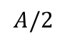
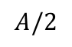
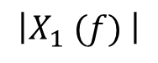
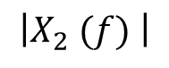
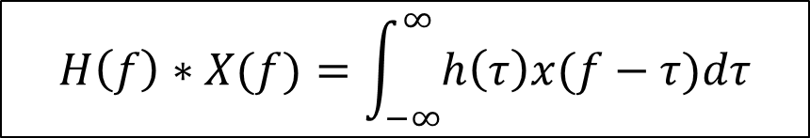
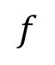
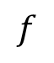
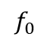
Example: Convolution 2 (Damped Symmetrically Oscillating Function)
$x_{1}\left(t\right)=e^{−a\left|t\right|}$, $x_{2}\left(t\right)=cos2πf_{0}t$
$$x\left(t\right)=x_{1}\left(t\right)x_{2}\left(t\right)=e^{−a\left|t\right|}cos2πf_{0}t$$
$$\left|X_{2} (f) \right|$$
$$A/2$$
$$A/2$$
$$−f_{0}$$
$$f_{0}$$
$$f$$
$$\left|X_{1} (f) \right|$$
$$H\left(f\right)∗X(f)=\int_{−∞}^{∞}{h\left(τ\right)x(f−τ)dτ}$$
$$f$$

Slide 12
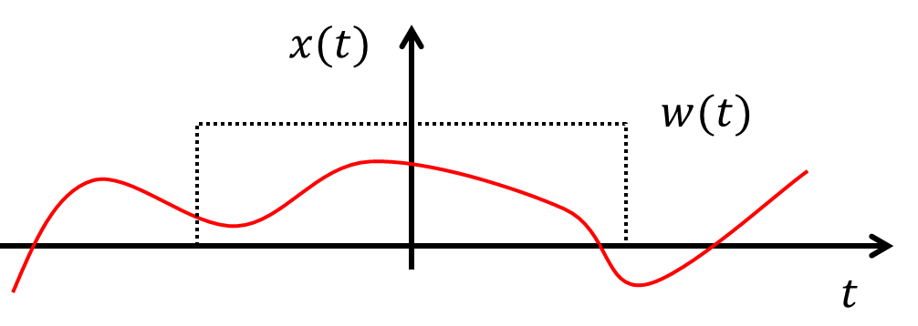
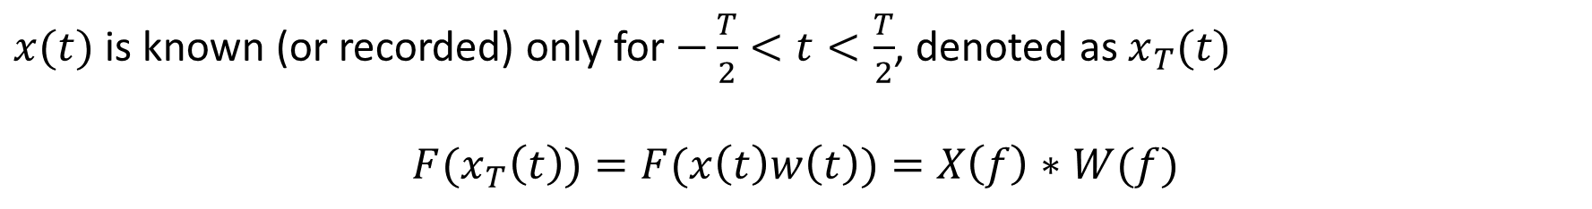
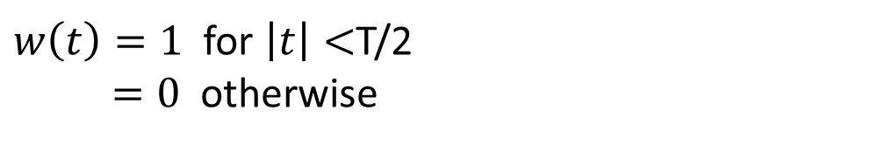
Effect of Data Truncation (Windowing) – Finite Signal
$w\left(t\right)=1$ for $\left|t\right|<$T/2
$=0$ otherwise
Q: How to represent a finite signal?
$x(t)$ is known (or recorded) only for $−\frac{T}{2}<t<\frac{T}{2}$, denoted as $x_{T}(t)$
$$F(x_{T}\left(t\right))=F(x\left(t\right)w\left(t\right))=X\left(f\right)∗W(f)$$
Fourier transform of the product of two-time signals is the convolution of their Fourier transforms.

Slide 13
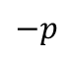
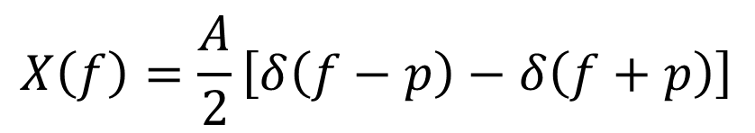
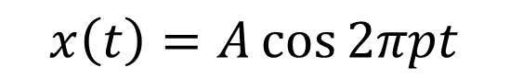
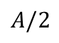
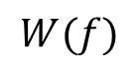
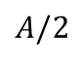
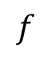
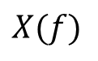
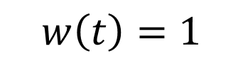


Revisit: Continuous Signal
Supplement
$$x\left(t\right)=A\cos{2πpt}$$
$$w\left(t\right)=1$$
$$X\left(f\right)=\frac{A}{2}\left[δ\left(f−p\right)−δ\left(f+p\right)\right]$$
$$W\left(f\right)=δ\left(f\right)$$
$$X(f)$$
$$W(f)$$
$$A/2$$
$$A/2$$
$$−p$$
$$p$$
$$f$$

Slide 14





















Truncated Sine Wave
$$x(t)$$
$$W(f)$$
$$w(t)$$
$$W\left(f\right)=\frac{T\sin{πfT}}{πfT}$$
$$T$$
$$1/T$$
$$\left|X_{1} (f) \right|$$
$$A/2$$
$$A/2$$
$$X\left(f\right)=\frac{A}{2}\left[δ\left(f−p\right)−δ\left(f+p\right)\right]$$
$$x\left(t\right)=A\cos{2πpt}$$
$$−p$$
$$p$$
$$f$$
$$X_{T}(f)$$
$w\left(t\right)=a$ for $\left|t\right|<$ b
$=0$ for $\left|t\right|>$b
Smearing: Distortion due to the main lobe
Leakage: Distortion due to the side lobe
$$x_{T}\left(t\right)=x\left(t\right)w(t)$$
$$−p$$
$$p$$

Slide 15
















Effect of Data Truncation: Frequency Separation
$$\left|X(f) \right|$$
$x(t)$ is the sum of three sine (or cosine) waves
$$f_{0}$$
$$f_{1}$$
$$f_{2}$$
$$\left|X(f) \right|$$
$T_{p}$ Increase
Considerable smearing due to the spectral window
$$f_{0}$$
$$f_{1}$$
$$f_{2}$$
$$\left|X(f) \right|$$
Three components are resolved but with considerable leakage at other frequencies
$$f_{0}$$
$$f_{1}$$
$$f_{2}$$

Slide 16





Window Function
Supplement

Slide 17

Example: Hanning Window vs Rectangular Window
$$x\left(t\right)=A_{1}\sin{2πf_{1}t+A_{2}sin2{πf}_{2}t}+A_{3}sin2πf_{3}t$$

Slide 18



Example: Hanning Window vs Rectangular Window (Continue)
Original signal
Rectangular
Hanning
$$T=0.6s$$
$$T=1s$$
Black dotted lines indicate 10, 20, and 21 Hz
Tutorial

Slide 19


Example: Hanning Window vs Rectangular Window (Continue)
Original signal
Rectangular
Hanning
$$T=2s$$
$$T=4s$$
Black dotted lines indicate 10, 20, and 21 Hz
Tutorial

Slide 20















Impluse Train Modulation (Discretization)
A ‘train’ of delta functions $i\left(t\right)$is expressed as
$$i(t)$$
$$i\left(t\right)=\sum_{n=−∞}^{∞}{δ(t−n∆)}$$
$$Δ$$
$$t$$
$$f_{S}=\frac{1}{∆}$$
The sampling procedure can be illustrated as
$x_{s}\left(t\right)=x\left(t\right)i\left(t\right)=x(n∆$)
$$x(t)$$
$$i(t)$$
$$x_{s}(t)$$
$$×$$
$$=$$
$$t$$
$$t$$
$$t$$
$$X_{s}\left(f\right)=\int_{−∞ }^{∞ }{\left[x(t)\sum_{n=−∞}^{∞}{δ(t−n∆)}\right]e^{−i2πft}dt}=\sum_{n=−∞}^{∞}{\left[\int_{−∞ }^{∞ }{{x(t)e}^{−i2πft}δ(t−n∆)dt}\right]=\sum_{n=−∞}^{∞}{x(n∆)e^{−i2πfn∆}}}$$
Q: What is the difference between $X_{s}\left(f\right)$ and $X\left(f\right)$?

Slide 21





Impluse Train Modulation (Continue)
$r$: integer
$$X_{s}\left(f+r/∆\right)=\sum_{n=−∞}^{∞}{x(n∆)e^{−i2π(f+r/∆)n∆}}=\sum_{n=−∞}^{∞}{x(n∆)e^{−i2πfn∆−i2πrn}}=\sum_{n=−∞}^{∞}{x\left(n∆\right)e^{−i2πfn∆}=X_{s}(f)}$$
Q: Meaning?
$$X_{s}\left(f\right)=\sum_{n=−∞}^{∞}{x(n∆)e^{−i2πfn∆}}$$
Multiplying both sides of equation by $e^{−i2πfr∆}$ and integrating w.r.t $f$
$$\int_{−1/2∆}^{1/2∆}{X_{s}(f)e^{−i2πfr∆}df}=\int_{−1/2∆}^{1/2∆}{\left[\sum_{n=−∞}^{∞}{x\left(n∆\right)e^{−i2πfn∆}}\right]e^{−i2πfr∆}df}=\sum_{n=−∞}^{∞}{\int_{−1/2∆}^{1/2∆}{\left[x\left(n∆\right)e^{−i2πfn∆}\right]e^{−i2πfr∆}df}}=\sum_{n=−∞}^{∞}{x\left(n∆\right)\int_{−1/2∆}^{1/2∆}{\left[e^{−i2πf(n−r)∆}\right]df}=}x\left(r∆\right)\frac{1}{∆}$$
Use L'Hôpital's rule
$$f_{S}=\frac{1}{∆}$$
$$X_{s}(f)=\sum_{n=−∞}^{∞}{x(n∆)e^{−i2πfn∆}}$$
$$x\left(n∆\right)=∆ \int_{−1/2∆}^{1/2∆}{X_{s}(f)e^{i2πfn∆}df}$$
Q: What are these equation?

Slide 22

Impluse Train Modulation (Continue) - Proof
Supplement

Slide 23






Link Between Fourier Transform of a Discrete Sequence and Continuous Signal
Fourier coefficients
$$x\left(t\right)=\sum_{n=−∞}^{∞}{c_{n}e^{i2πnt/T_{p}}}$$
$$c_{n}=\frac{1}{T_{p}}\int_{0}^{T_{p}}{x\left(t\right)e^{−i2πnt/T_{p}}dt}$$
Impluse train
$$i\left(t\right)=\sum_{m=−∞}^{∞}{δ(t−m∆)}$$
$$c_{n}=\frac{1}{∆}\int_{−1/∆}^{1/∆}{\sum_{m=−∞}^{∞}{δ(t−m∆)}e^{−i2πnt/∆}dt}==\frac{1}{∆}\int_{−1/∆}^{1/∆}{δ(t)e^{−i2πnt/∆}dt}=\frac{1}{∆}$$
Fourier Transform of the impulse train
$$I\left(f\right)=F\left(i\left(t\right)\right)=\int_{−∞}^{∞}{i(t)e^{−i2πft}dt}=\int_{−∞}^{∞}{\sum_{n=−∞}^{∞}{c_{n}e^{\frac{i2πnt}{T_{p}}}}∙e^{−i2πft}dt}=\int_{−∞}^{∞}{\sum_{n=−∞}^{∞}{\frac{1}{∆}e^{\frac{i2πnt}{∆}}}∙e^{−i2πft}dt=\frac{1}{∆}\sum_{n=−∞}^{∞}{\int_{−∞}^{∞}{e^{\frac{i2πnt}{∆}}{∙e}^{−i2πft}dt=\frac{1}{∆}\sum_{n=−∞}^{∞}{\int_{−∞}^{∞}{e^{−i2π\left(f−\frac{n}{∆}\right)t}dt}}}}}=\frac{1}{∆}\sum_{n=−∞}^{∞}{δ(f−\frac{n}{∆})}$$

Slide 24






Link Between Fourier Transform of a Discrete Sequence and Continuous Signal (Continue)
Fourier Transform of a discrete sequence, $x_{s}\left(t\right)=x\left(t\right)i\left(t\right)$
$$X_{s}\left(f\right)=I\left(f\right)∗X\left(f\right)=\int_{−∞ }^{∞ }{I\left(g\right)X\left(f−g\right)dg}=\int_{−∞ }^{∞ }{\frac{1}{∆}\sum_{n=−∞}^{∞}{δ\left(g−\frac{n}{∆}\right)}X\left(f−g\right)dg}=\frac{1}{∆}\sum_{n=−∞}^{∞}{\int_{−∞ }^{∞ }{δ\left(g−\frac{n}{∆}\right)}X\left(f−g\right)dg }=\frac{1}{∆}\sum_{n=−∞}^{∞}{X\left(f−\frac{n}{∆}\right)}=\frac{1}{∆}\left(…+X\left(f−\frac{2}{∆}\right)+X\left(f−\frac{1}{∆}\right)+X\left(f\right)+X\left(f+\frac{1}{∆}\right)+ …\right)$$
$$X_{s}\left(f\right)$$
$$X(f)$$
$$−\frac{1}{2∆}$$
$$\frac{1}{2∆}$$
Q: What happened if ∆ goes to a zero?

Slide 25













































Example: Wagon-Wheel Effect
$$X_{s}(f)$$
$$X_{s}\left(f\right)=\frac{1}{∆}\sum_{n=−∞}^{∞}{X\left(f−\frac{n}{∆}\right)}=f_{s}\sum_{n=−∞}^{∞}{X\left(f−nf_{s}\right)}$$
$$\frac{1}{∆}\left(…+X\left(f−\frac{2}{∆}\right)+X\left(f−\frac{1}{∆}\right)+X\left(f\right)+X\left(f+\frac{1}{∆}\right)+ …\right)$$
$$X(f)$$
$$40Hz$$
$$−60Hz$$
$$60Hz$$
$$−100Hz$$
$$100Hz$$
$$X\left(f\right)$$
$${−f}_{s}$$
$$f_{0}$$
$$f_{N}$$
$$f_{N}$$
$$f_{0}$$
$$f_{s}$$
$${−f}_{s}$$
$$f_{0}$$
$$f_{N}$$
$$f_{N}$$
$$f_{0}$$
$$f_{s}$$
$$X_{s}(f)$$
$$40Hz$$
$$X_{s}(f)$$
$$X\left(f+f_{s}\right)$$
$$40Hz$$
$${−f}_{s}$$
$$f_{0}$$
$$f_{N}$$
$$f_{N}$$
$$f_{0}$$
$$f_{s}$$
$$X_{s}(f)$$
$${−f}_{s}$$
$$f_{0}$$
$$f_{N}$$
$$f_{N}$$
$$f_{0}$$
$$f_{s}$$
$$40Hz$$
$$X_{s}\left(f\right)=X\left(f\right)+X\left(f−f_{S}\right)+X\left(f+f_{s}\right)+ …$$
$$X\left(f−f_{S}\right)$$
$${−f}_{s}$$
$$f_{0}$$
$$f_{N}$$
$$f_{N}$$
$$f_{0}$$
$$f_{s}$$

Slide 26













Example: Wagon-Wheel Effect 2
$$X_{s}\left(f\right)=\frac{1}{∆}\sum_{n=−∞}^{∞}{X\left(f−\frac{n}{∆}\right)}=f_{s}\sum_{n=−∞}^{∞}{X\left(f−nf_{s}\right)}$$
$$\frac{1}{∆}\left(…+X\left(f−\frac{2}{∆}\right)+X\left(f−\frac{1}{∆}\right)+X\left(f\right)+X\left(f+\frac{1}{∆}\right)+ …\right)$$
$$X(f)$$
$$−100Hz$$
$$−60Hz$$
$$60Hz$$
$$100Hz$$
$${−f}_{0}$$
$${−f}_{s}$$
$$f_{s}$$
$$f_{0}$$
$$X_{s}(f)$$
$$40Hz$$
$${−f}_{0}$$
$${−f}_{s}$$
$$f_{s}$$
$$f_{0}$$
$$X_{s}\left(f\right)=X\left(f\right)+X\left(f−f_{S}\right)+X\left(f+f_{s}\right)+ …$$

Slide 27
















Revisit: Spaceship Helicopter
$$X_{s}\left(f\right)=\frac{1}{∆}\sum_{n=−∞}^{∞}{X\left(f−\frac{n}{∆}\right)}=f_{s}\sum_{n=−∞}^{∞}{X\left(f−nf_{s}\right)}$$
$$X(f)$$
Props frequency = 540 RPM
…
$$f_{s}=60Hz$$
$${2f}_{s}$$
$${3f}_{s}$$
$${4f}_{s}$$
$$f_{0}$$
$$X(f)$$
$$X_{S}(f)$$
$$−\frac{1}{2∆}$$
…
$$\frac{1}{2∆}$$
$$f_{s}$$
$$f_{0}−{2f}_{s}$$
$$f_{0}−f_{s}$$
$$f_{0}$$
$f_{0}=mf_{s}$ 𝑤ℎ𝑒𝑟𝑒 𝑚=𝑖𝑛𝑡𝑒𝑔𝑒𝑟
The frequency is wrapped around to zero frequency!!

Slide 28





Discrete Fourier Transform
So far, we have considered sequences that run over the range −∞ < n < ∞(n integer). For the special case where the sequence is of finite length (i.e. non-zero for a finite number of values) an alternative Fourier representation is possible called the discrete Fourier transform (DFT).
It turns out that the DFT is a Fourier representation of a finite length sequence and is itself a sequence rather than a continuous function of frequency, and it corresponds to samples, equally spaced in frequency, of the Fourier transform of the signal. The DFT is fundamental to many digital signal processing algorithms.
$$X_{s}(f)=\sum_{n=−∞}^{∞}{x(n∆)e^{−i2πfn∆}}$$
Continuous in frequency
Repeated every 1/ $∆$
$$X(k)=\sum_{n=0}^{N−1}{x(n)e^{−i\frac{2π}{N}nk}}$$
$$f=\frac{k}{N∆}$$
DFT of a finite (sampled) sequence $x(n∆)$
$X\left(k\right)$ is $X_{s}(f)$ evaluated at $f=\frac{k}{N∆}$ Hz ($k$ integer)
$$x(n)=\frac{1}{N}\sum_{n=0}^{N−1}{X(k)e^{i\frac{2π}{N}nk}}$$
Q: How do we store frequency signals?
Inverse DFT

Slide 29





Discrete Fourier Transform (Continue)
Fourier transform of a continuous time signal $x(t)$
$$X\left(f\right)=\int_{−∞}^{∞}{x\left(t\right)e^{−i2πft}dt}$$
Fourier transform of a discrete sequence $x(n∆)$
$$X_{s}(f)=\sum_{n=−∞}^{∞}{x(n∆)e^{−i2πfn∆}}$$
Fourier transform of a discrete finite sequence $x(n)$
$$X_{s}(f)=\sum_{n=0}^{N−1}{x(n)e^{−i2πfn∆}}$$
Discrete Fourier transform of a discrete finite sequence $x(n)$
$$X(k)=\sum_{n=0}^{N−1}{x(n)e^{−i\frac{2π}{N}nk}}$$
$X\left(k\right)$ is $X_{s}(f)$ evaluated at $f=\frac{k}{N∆}$ Hz ($k$ integer)
Tutorial

Slide 30



Fast Fourier Transform
A fast Fourier transform (FFT) is an algorithm that computes the discrete Fourier transform (DFT) of a sequence, or its inverse (IDFT). Fourier analysis converts a signal from its original domain (often time or space) to a representation in the frequency domain and vice versa. It manages to reduce the complexity of computing the DFT from $O\left(n^{2}\right)$, which arises if one simply applies the definition of DFT, to $O\left(n log n\right)$, where $n$ is the data size.
$$X(k)=\sum_{n=0}^{N−1}{x(n)e^{−i\frac{2π}{N}nk}}$$
FFT in Matlab
Y = fft(X) computes the discrete Fourier transform (DFT) of X using a fast Fourier transform (FFT) algorithm
Y = fft(X,n) returns the n-point DFT. If no value is specified, Y is the same size as X.

Slide 31



Example: Fourier Transform of a Discrete Signal
$$x\left(t\right)=e^{−a\left|t\right|}cos2πf_{0}t$$
$$X\left(f\right)=\frac{a}{a^{2}+{\left[2π\left(f−f_{0}\right)\right]}^{2}}+\frac{a}{a^{2}+{\left[2π\left(f+f_{0}\right)\right]}^{2}}$$
$$X\left(f\right)=\int_{−∞}^{∞}{x\left(t\right)e^{−i2πft}dt}$$
Note that –n and –a indicate numerical and analytical integration for Fourier transformation.

Slide 32






Example: Fourier Transform of a Discrete Signal (Continue)
$$x\left(t\right)=e^{−a\left|t\right|}cos2πf_{0}t$$
$$X\left(f\right)=\frac{a}{a^{2}+{\left[2π\left(f−f_{0}\right)\right]}^{2}}+\frac{a}{a^{2}+{\left[2π\left(f+f_{0}\right)\right]}^{2}}$$
$$X\left(f\right)=\int_{−∞}^{∞}{x\left(t\right)e^{−i2πft}dt}$$
$$X_{s}(f)=\sum_{n=−∞}^{∞}{x(n∆)e^{−i2πfn∆}}$$
$$x_{s}\left(t\right)=x\left(t\right)i\left(t\right)$$
$$X(f)$$
$$X_{s}\left(f\right)=I\left(f\right)∗X\left(f\right)=\frac{1}{∆}\sum_{n=−∞}^{∞}{X\left(f−\frac{n}{∆}\right)}$$
$$=\frac{1}{∆}\left(…+X\left(f−\frac{1}{∆}\right)+X\left(f\right)+X\left(f+\frac{1}{∆}\right)+ …\right)$$
$$−\frac{1}{2∆}$$
$$\frac{1}{2∆}$$

Slide 33

Example: Fourier Transform of a Discrete Signal (No Aliasing)
a = 3; f0 = 4; x1 = @(t) exp(-a.*abs(t)).* cos(2*pi*f0*t); fs = 100; dt = 1/fs; t = -2:dt:2-dt; xn = x1(t); Xf = @(f) a./(a^2+ (2*pi*(f-f0)).^2) + a./(a^2+ ... (2*pi*(f+f0)).^2) ; % Xf Xsf = @(f) 1/fs*sum(xn.*exp(-sqrt(-1)*2*pi*f*t), 2); % Xsf fig1 = figure(1); subplot(121); f = [-10:0.05:10]'; plot(f,abs(Xf(f)),'-r', 'linewidth', 2); hold on; plot(f,abs(Xsf(f)),':b', 'linewidth', 2); hold off; subplot(122); f = [-250:0.05:250]'; plot(f,abs(Xf(f)),'-r', 'linewidth', 2); hold on; plot(f,abs(Xsf(f)),':b', 'linewidth', 2); hold off;
$$X_{s}(f)=\sum_{n=−∞}^{∞}{x(n∆)e^{−i2πfn∆}}$$
Tutorial

Slide 34
Example: Fourier Transform of a Discrete Signal (Aliasing)
a = 3; f0 = 4; x1 = @(t) exp(-a.*abs(t)).* cos(2*pi*f0*t); fs = 10; dt = 1/fs; t = -2:dt:2-dt; xn = x3(t); Xf = @(f) a./(a^2+ (2*pi*(f-f0)).^2) + a./(a^2+ ... (2*pi*(f+f0)).^2) ; % Xf Xsf = @(f) 1/fs*sum(xn.*exp(-sqrt(-1)*2*pi*f*t), 2); % Xsf fig1 = figure(1); subplot(121); f = [-10:0.05:10]'; plot(f,abs(Xf(f)),'-r', 'linewidth', 2); hold on; plot(f,abs(Xsf(f)),':b', 'linewidth', 2); hold off; subplot(122); f = [-30:0.05:30]'; plot(f,abs(Xf(f)),'-r', 'linewidth', 2); hold on; plot(f,abs(Xsf(f)),':b', 'linewidth', 2); hold off;
Tutorial

Slide 35



Example: Discrete Fourier Transform
a = 3; f0 = 4; x1 = @(t) exp(-a.*abs(t)).* cos(2*pi*f0*t); fs = 100; dt = 1/fs; t = -2:dt:2-dt; xn = x1(t); Xf = @(f) a./(a^2+ (2*pi*(f-f0)).^2) + a./(a^2+... (2*pi*(f+f0)).^2); % Xf % use of a 'fft' function nfft = numel(xn); Xk = fft(xn, nfft); f = 1/(nfft*dt) * (0:nfft/2-1); figure(1) plot(f,abs(Xf(f)),'-b', 'linewidth', 2);hold on; plot(f,1/fs*abs(Xk(1:(nfft/2))),':r', 'linewidth', 2);
$X\left(k\right)$ is $X_{s}(f)$ evaluated at $f=\frac{k}{N∆}$ Hz ($k$ integer)
$$X_{s}(f)=\sum_{n=0}^{N−1}{x(n)e^{−i2πfn∆}}$$
$$X(k)=\sum_{n=0}^{N−1}{x(n)e^{−i\frac{2π}{N}nk}}$$
Tutorial

Slide 36

Zero-Padding
Y = fft(X, n) returns the n-point DFT. If no value is specified, Y is the same size as X.
If X is a vector and the length of X is less than n, then X is padded with trailing zeros to length n.
If X is a vector and the length of X is greater than n, then X is truncated to length n.
$$X(k)=\sum_{n=0}^{N−1}{x(n)e^{−i\frac{2π}{N}nk}}$$
$X\left(k\right)$ is $X_{s}(f)$ evaluated at $f=\frac{k}{N∆}$ Hz
frequency spacing $\frac{1}{N∆}$ Hz

Slide 37


Zero-Padding (Continue)
$\hat{x}\left(t\right)=x(n)$ for $0≤n≤N−1$
$=0 \text{for} N≤n≤L−1$
$$\hat{X}(k)=\sum_{n=0}^{L−1}{\hat{x}\left(n\right)e^{−i\frac{2π}{L}nk}=}\sum_{n=0}^{N−1}{x\left(n\right)e^{−i\frac{2π}{L}nk}}$$
“Finer” spacing in the frequency domain. However, the zero padding does not increase the “true” resolution.
Vibration problems, this can be used to obtain the fine detail near resonances
See the slide of “effect of data truncation”

Slide 38




Example: Zero-Padding Effect (Does not Increase a True Resolution)
Black dotted lines indicate 10, 20, and 21 Hz
$$T=0.6$$
$$T=0.6$$
+ zero padding (2.4 s)
Tutorial

Slide 39

Example: Zero-Padding Effect (Still Useful for Obtaining the Detail)
Tutorial

Slide 40


Waveform VS FFT Frequency Resolution
Supplement
The “waveform frequency resolution” is the minimum spacing between two frequencies that can be resolved. The “FFT resolution” is the number of points in the spectrum, which is directly proportional to the number points used in the FFT. It is possible to have extremely fine FFT resolution, yet not be able to resolve two coarsely separated frequencies. It is also possible to have fine waveform frequency resolution but have the peak energy of the sinusoid spread throughout the entire spectrum (this is called FFT spectral leakage).
The waveform frequency resolution is defined by the following equation:
where T is the time length of the signal with data. It’s important to note here that you should not include any zero padding in this time! Only consider the actual data samples.
It’s important to make the connection here that the discrete time Fourier transform (DTFT) or FFT operates on the data as if it were an infinite sequence with zeros on either side of the waveform. This is why the FFT has the distinctive sinc function shape at each frequency bin. You should recognize the waveform resolution equation 1/T is the same as the space between nulls of a sinc function.
The FFT resolution is defined by the following equation:
https://www.bitweenie.com/listings/fft-zero-padding

